Slide 1

Apache CASSANDRA - Essentials
29.04.2016 Goldschmiede anderScore by Maz Rashid, maz@mazcity.de @geeky4lks

Slide 2
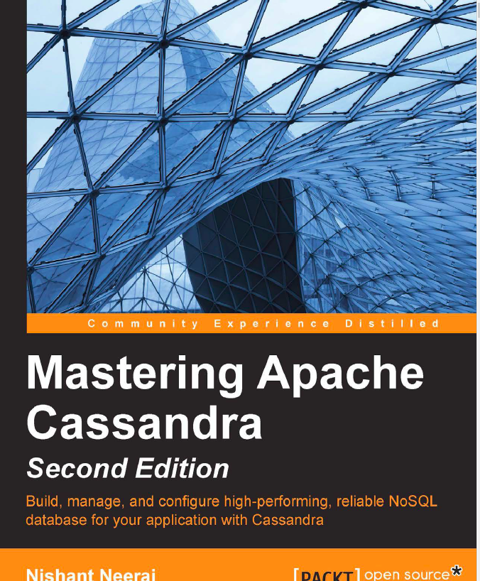
What is Apache Cassandra
Quoting from Wikipedia:
"Apache Cassandra is an open source distributed database management system
designed to handle large amounts of data across many commodity servers,
providing high availability with no single point of failure. Cassandra offers robust
support for clusters spanning multiple datacenters, with asynchronous masterless
replication allowing low latency operations for all clients."

Slide 3
What is Apache Cassandra
Distributed Database
High Available
Integrated Replication
Across Datacenters
Tunable Consistency
Lightweight
Easy Operations
Combined advanced Technologies from
Amazon
Google
…
Broad usage by
Netflix (largest setup ever)
And other Big Players

Slide 4
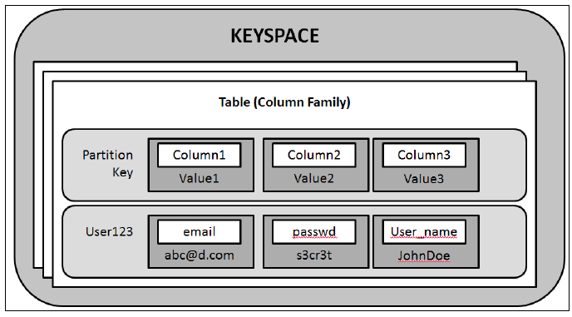
Datamodel & Terminology
CREATE TABLE customers (
id uuid,
email text,
PRIMARY KEY (id)
)
CREATE TABLE country_states (
country text,
state text,
population int,
PRIMARY KEY (country, state)
)

Slide 5
Datamodel & Terminology
CREATE TABLE country_chiefs (
country text,
prez_name text,
num_states int,
capital text,
ruling_year int,
PRIMARY KEY ((country, prez_name), num_states,
capital)
)

Slide 6
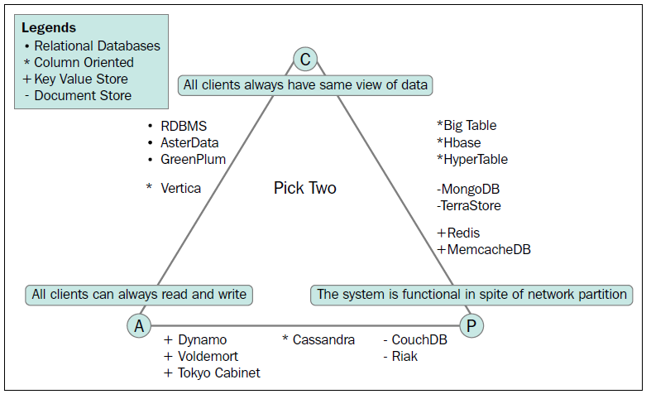
CAP Theorem
"A distributed system requiring always-on, highly-available operations cannot
guarantee the illusion of coherent, consistent single-system operation in the presence
of network partitions, which cut communication between active servers“ - Eric Brewer 2000

Slide 7
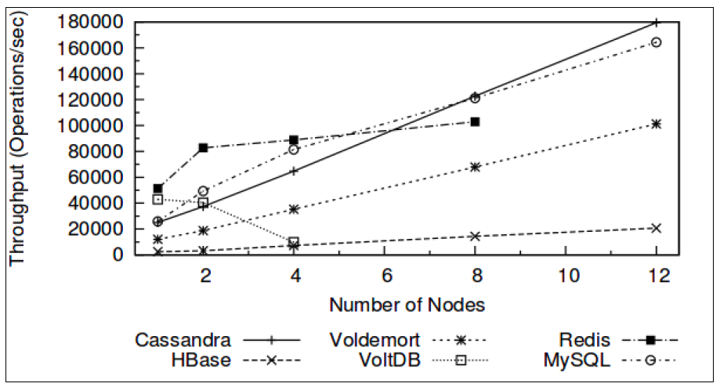
Cassandra provides linear scalAbility (Read Throuput)

Slide 8
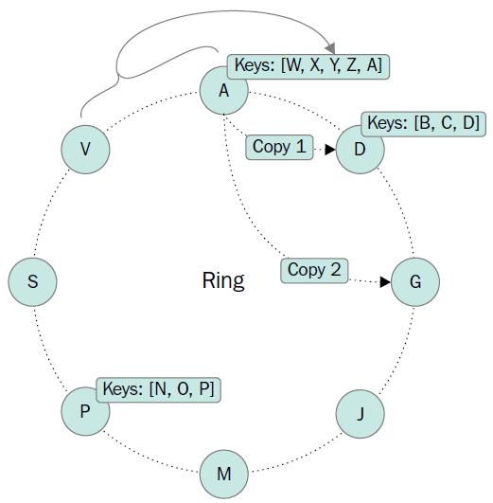
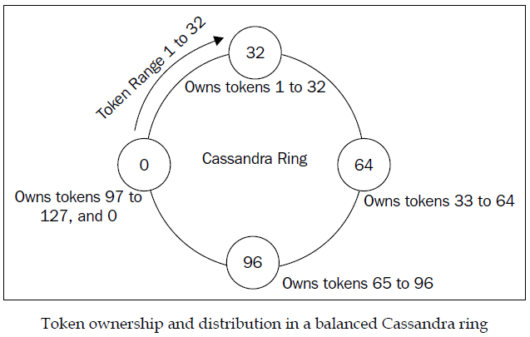
Data Distribution

Slide 9
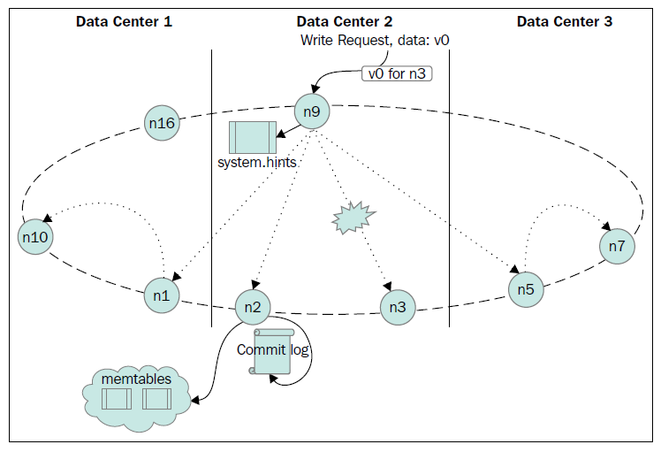
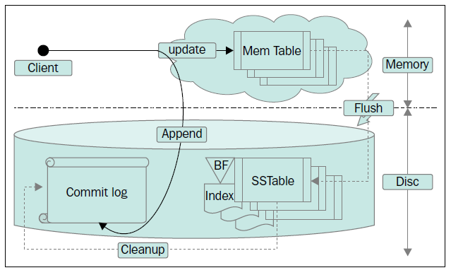
Handling Writes

Slide 10
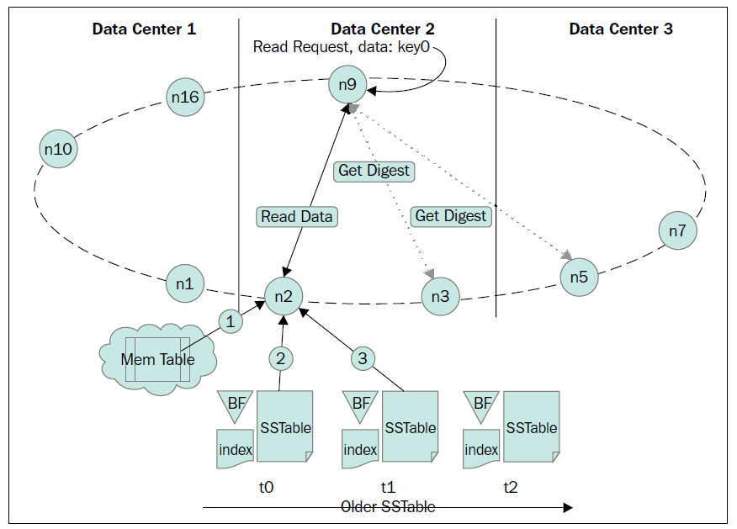
Handling READS

Slide 11
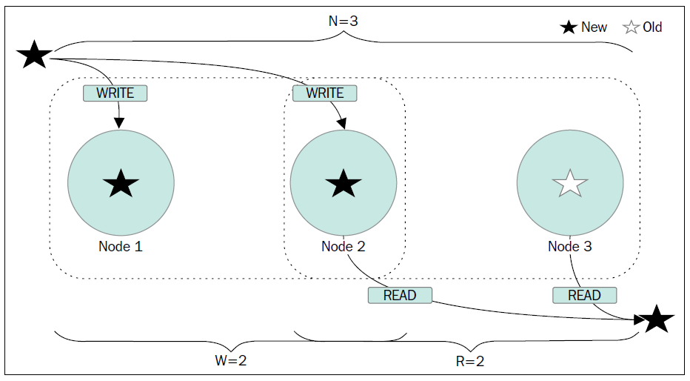
Tunable Consistency
Strong Consistency when
R + W > N
N: Replicaion Factor
R: Read Factor
W: Write Factor

